Slide 1
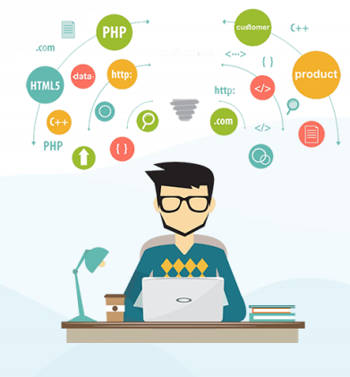
Whitebox Testing & Blackbox Testing
Program Studi Teknik Informatika

Slide 2

Outline
Whitebox Testing
Blackbox Testing
Whitebox VS Blackbox Testing

Slide 3

White Box Testing

Slide 4
Apa itu White Box Testing?
White Box Testing adalah Pengujian terhadap struktur internal, rancangan serta kode program dari suatu Perangkat Lunak.
Kode program harus dapat dilihat oleh tester.
Biasanya dilakukan oleh pengembang atau programmer perangkat lunak.
Disebut juga Clear Box Testing, Open Box Testing, Structural Testing, Transparent Box Testing, Glass Box Testing, Code-based Testing.
Notes:
Basic knowledge of Linux commands: Most of the software applications like Web-Services, Databases, Application Servers are deployed on Linux machines.So it is crucial for testers to have knowledge about Linux commands.
Knowledge and hands-on experience of a Test Management Tool:Test Management is an important aspect of Software testing. Without proper test management techniques, software testing process will fail. Test management is nothing but managing your testing related artifacts.For example - A tool like Testlink can be used for tracking all the test cases written by your team.
Basic knowledge of Database/ SQL: Software Systems have a large amount of data in the background. This data is stored in different types of databases like Oracle, MySQL, etc. in the backend. So, there will be situations when this data needs to be validated. In that case, simple/complex SQL queries can be used to check whether proper data is stored in the backend databases.
There are other tools available that can be utilized for Test Management. So, it is important to have knowledge and working experience of such tools because they are used in most of the companies.
Knowledge and hands-on experience of any Defect Tracking tool- Defect Tracking and Defect life cycle are key aspects of software testing. It is extremely critical to managing defects properly and track them in a systematic manner. Defect tracking becomes necessary because the entire team should know about the defect including managers, developers, and testers. Several tools are used to lock defects including QC, Bugzilla, Jira, etc.
Knowledge and hands-on experience of Automation tool: If you see yourself as an "Automation tester" after a couple of years working on manual testing, then you must master a tool and get in-depth, hands-on knowledge of automation tools.Note - Only knowledge of any Automation tool is not sufficient to crack the interview, you must have good hands-on experience, so practice the tool of your choice to achieve mastery. Knowledge of any scripting language like VBScript, JavaScript, C# is always helpful as a tester if you are looking for a job into automation. Few companies also use Shell/Perl scripting, and there is a lot of demand for testers having knowledge of the same. Again, it will depend on the company and which tools are used by that company.

Slide 5
Tujuan White Box Testing
Verifikasi alur input-output dalam suatu aplikasi
Meningkatkan rancangan dan usabilitas
Memperkuat keamanan

Slide 6
Apa yang Diuji dalam White Box Testing?
Aliran input tertentu yang melalui kode program
Output yang diharapkan
Jalur yang jelek atau rusak dalam proses pembuatan kode program
Lubang keamanan internal
Fungsi suatu kondisi loop
Pengujian setiap baris perintah, objek dan fungsi

Slide 7
Tahapan dalam White Box Testing
Pemahaman Kode Program
Hal yang pertama perlu dilakukan tester adalah mempelajari dan memahami kode program. Tester harus paham bahasa pemrograman yang digunakan serta keamanan dalam program. Tester juga harus dapat menemukan isu keamanan dan mencegah serangan dari hacker atau pengguna biasa yang mungkin memasukkan kode malicious ke dalam aplikasi secara sadar atau tidak.
Pembuatan dan Eksekusi Test Case
Tester membuat beberapa test case untuk tiap proses maupun serangkaian proses dalam aplikasi. Selanjutnya melakukan pengujian manual atau otomatis sesuai test case yang telah dibuat.

Slide 8
Teknik White Box Testing
Basis Path Testing
Data Flow Testing
Loop Testing

Slide 9
Tools untuk White Box Testing
JUnit
NUnit
JSUnit
CppUnit
Veracode
EclEmma

Slide 10
Keuntungan White Box Testing
Optimisasi kode dengan menemukan error yang tersembunyi
Test case untuk white box dapat diotomatisasi dengan mudah
Pengujian lebih menyeluruh karena semua jalur kode telah dicek
Pengujian dapat dimulai lebih awal dalam SDLC meskipun tampilan GUI belum ada

Slide 11
Kekurangan White Box Testing
Pengujian dengan White Box Testing bisa menjadi kompleks dan mahal
Pengembang yang mengeksekusi test case terkadang mengabaikannya, sehingga white box testing dengan pengembang yang tidak detail dapat memicu adanya error.
Membutuhkan tenaga professional dengan pemahaman detail tentang pemrograman dan implementasi
Memakan waktu, terutama pada aplikasi besar membutuhkan banyak waktu untuk pengujian menyeluruh.

Slide 12
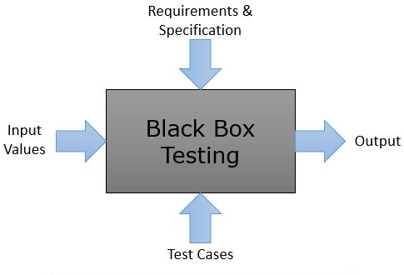
Black Box Testing

Slide 13
Apa itu Black Box Testing?
Black Box Testing adalah Pengujian terhadap fungsionalitas suatu aplikasi tanpa melihat struktur internal, detail implementasi atau jalur dari suatu Perangkat Lunak.
Berbasis spesifikasi dan kebutuhan perangkat lunak.
Fokus pada input output suatu aplikasi.
Notes:
Basic knowledge of Linux commands: Most of the software applications like Web-Services, Databases, Application Servers are deployed on Linux machines.So it is crucial for testers to have knowledge about Linux commands.
Knowledge and hands-on experience of a Test Management Tool:Test Management is an important aspect of Software testing. Without proper test management techniques, software testing process will fail. Test management is nothing but managing your testing related artifacts.For example - A tool like Testlink can be used for tracking all the test cases written by your team.
Basic knowledge of Database/ SQL: Software Systems have a large amount of data in the background. This data is stored in different types of databases like Oracle, MySQL, etc. in the backend. So, there will be situations when this data needs to be validated. In that case, simple/complex SQL queries can be used to check whether proper data is stored in the backend databases.
There are other tools available that can be utilized for Test Management. So, it is important to have knowledge and working experience of such tools because they are used in most of the companies.
Knowledge and hands-on experience of any Defect Tracking tool- Defect Tracking and Defect life cycle are key aspects of software testing. It is extremely critical to managing defects properly and track them in a systematic manner. Defect tracking becomes necessary because the entire team should know about the defect including managers, developers, and testers. Several tools are used to lock defects including QC, Bugzilla, Jira, etc.
Knowledge and hands-on experience of Automation tool: If you see yourself as an "Automation tester" after a couple of years working on manual testing, then you must master a tool and get in-depth, hands-on knowledge of automation tools.Note - Only knowledge of any Automation tool is not sufficient to crack the interview, you must have good hands-on experience, so practice the tool of your choice to achieve mastery. Knowledge of any scripting language like VBScript, JavaScript, C# is always helpful as a tester if you are looking for a job into automation. Few companies also use Shell/Perl scripting, and there is a lot of demand for testers having knowledge of the same. Again, it will depend on the company and which tools are used by that company.

Slide 14
Tahapan dalam Black Box Testing
Pemeriksaan spesifikasi dan kebutuhan sistem
Tester memilih input yang valid (skenario uji positif) dan input yang tidak valid (skenario uji negatif)
Tester menentukan output yang diharapkan untuk semua input
Tester membuat kasus uji dengan input yang dipilih
Kasus uji dieksekusi
Tester membandingkan output yang didapat dengan output yang diharapkan
Perbaiki jika ada kesalahan dan uji ulang

Slide 15
Jenis Black Box Testing
Pengujian Fungsional
Pengujian terhadap kebutuhan fungsional dari sistem.
Pengujian Non Fungsional
Pengujian ini tidak terkait dengan fungsionalitas tertentu, tetapi kebutuhan non fungsional antara lain performance, scalability, usability
Pengujian Regresi
Pengujian regresi dilakukan setelah kode diperbaiki, di-upgrade atau dilakukan maintenance untuk mengecek kode yang baru tidak mempengaruhi kode yang sudah ada.

Slide 16
Tools untuk Black Box Testing
Tools yang digunakan untuk Black Box Testing tergantung dari jenis Black Box Testing yang dilakukan.
Pengujian Fungsional dan Regresi dapat menggunakan QTP, Selenium
Pengujian Non-Fungsional dapat menggunakan LoadRunner, Jmeter

Slide 17
Teknik Black Box Testing
Equivalence Partitioning
Boundary Value Analysis/Limit Testing
Comparison Testing
Sample Testing
Robustness Testing
Behavior Testing
Requirement Testing
Performance Testing
Endurance Testing
Cause-Effect Relationship Testing

Slide 18
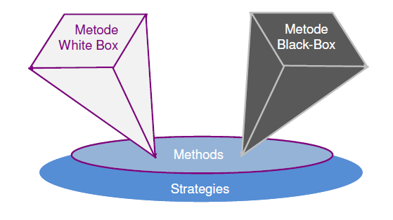
White Box Testing VS Black Box Testing

Slide 19
White Box Testing vs Black Box Testing
White Box Testing | Black Box Testing
Fokus pada validasi struktur internal dan kinerja kode program dalam perangkat lunak | Fokus utama pada validasi kebutuhan fungsional
Pengetahuan tentang bahasa pemrograman sangat penting, terlebih untuk sistem yang menggunakan berbagai bahasa pemrograman dan teknologi. | Memberikan abstraksi dari kode dan focus pada pengujian terhadap perilaku sistem
Tidak memfasilitasi pengujian untuk komunikasi antar modul | Memfasilitasi pengujian untuk komunikasi antar modul

Slide 20
TERIMAKASIH

